Slide 1

PORTAGE APL
GROUP - 29
Shivani Haridas
Elmy Luka
Varshini Burgula
Gowtham

Slide 4
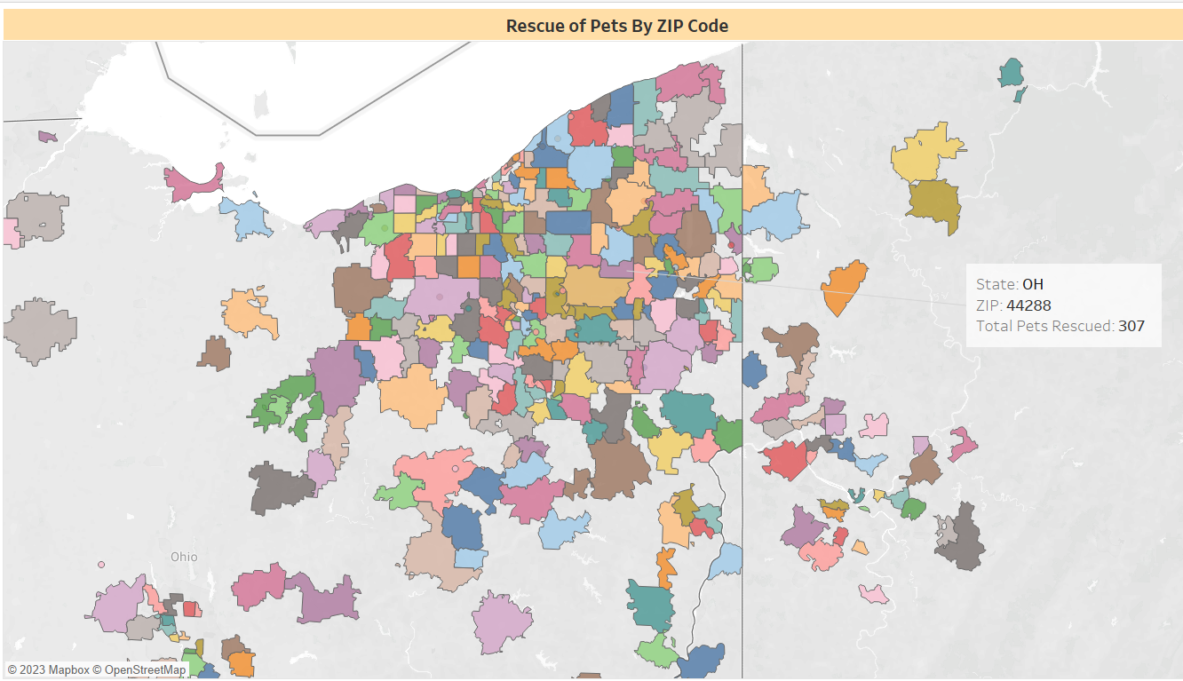

Slide 5
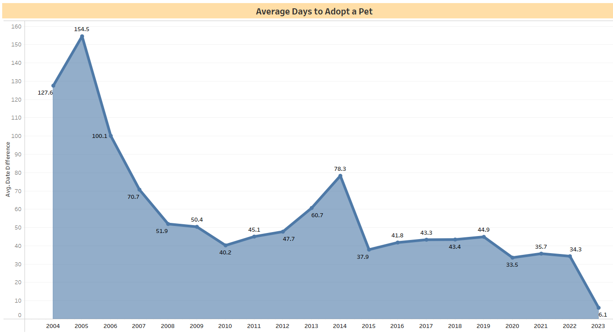

Slide 6
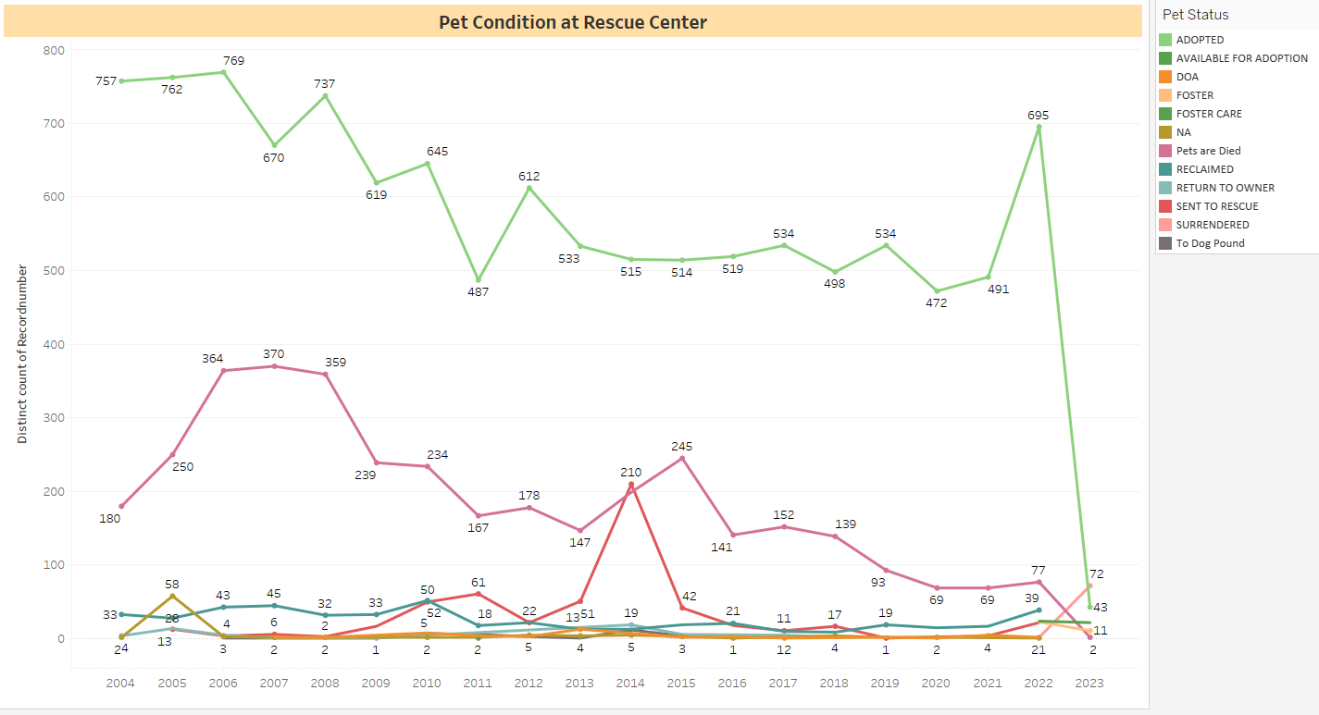

Slide 7
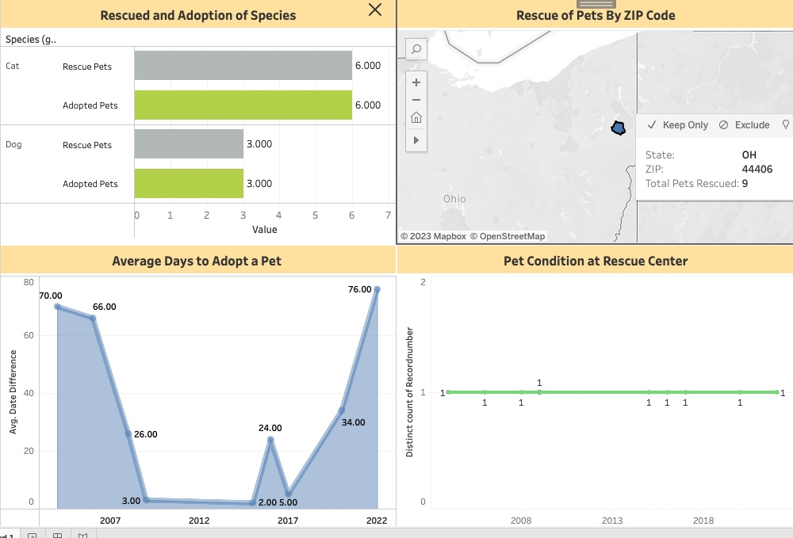

Slide 8
Thank you

